Slide 1

Logistics Warehouse Report
Tatiana Ilunga – ANLC 754

Slide 2
Introduction
This report has been prepared on the evaluation of the logistics warehouse dataset obtained from Kaggle https://www.kaggle.com/datasets/ziya07/logistics-warehouse-dataset
It consists 3204 observations and 23 variables

Slide 3
Business Problem
Effective inventory management is essential for maintaining product availability while minimizing excess inventory and associated carrying costs. Organizations that rely on static or poorly aligned reorder policies risk stock shortages, inefficient warehouse operations, and reduced customer satisfaction. This project analyzes operational logistics data to evaluate whether current inventory practices reflect observed product demand and to identify opportunities for improving inventory replenishment decisions through data-driven analysis.

Slide 4
Observations
Identifiers
Warehouse zone
Inventory metrics
Reorder policy metrics
Lead time
Demand measures
Operational KPIs

Slide 5
Variables
Stock level
Reorder point
Daily demand
Zone
Lead time days
Reorder frequency days
Demand st dev
Stockout count last month
Order fulfillment rate

Slide 6
Bias or Limitations
Snapshot in time
Not a time series validation
Static inventory dynamics
Supplier lead time are not the causal drivers

Slide 7
Data Modeling & Analysis
Descriptive Analysis
Daily demand by category
Under-stock items by Zone
Zone B and C are most understocked; however, each zone is understocked.
Zone A: 59 | Zone B: 62 | Zone C: 60 | Zone D: 56

Slide 8
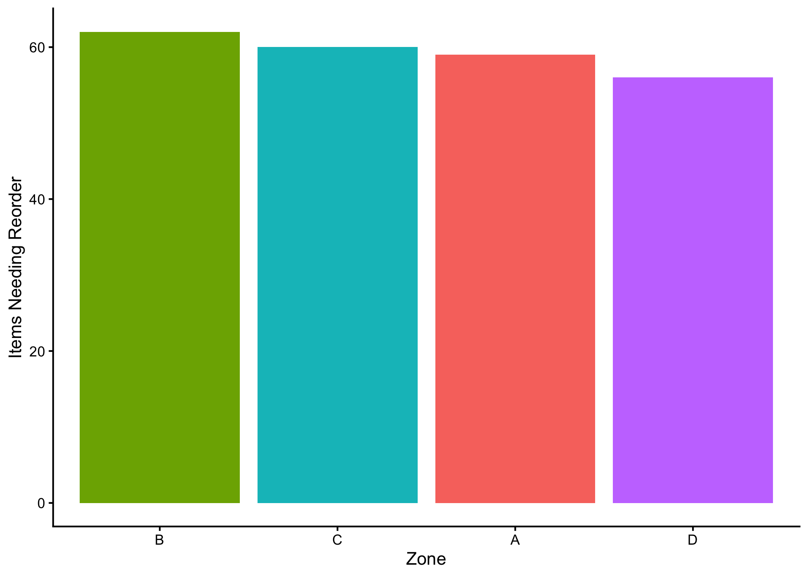
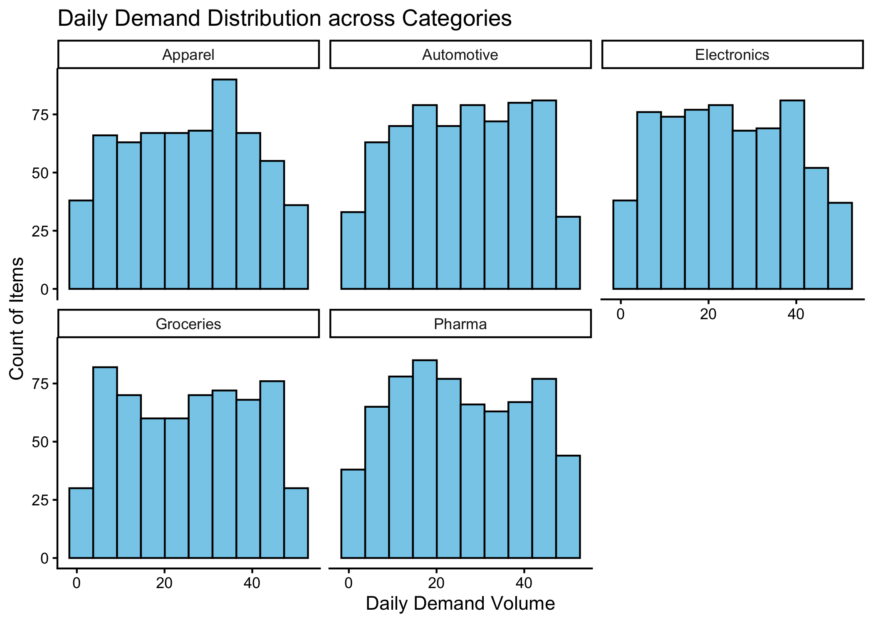
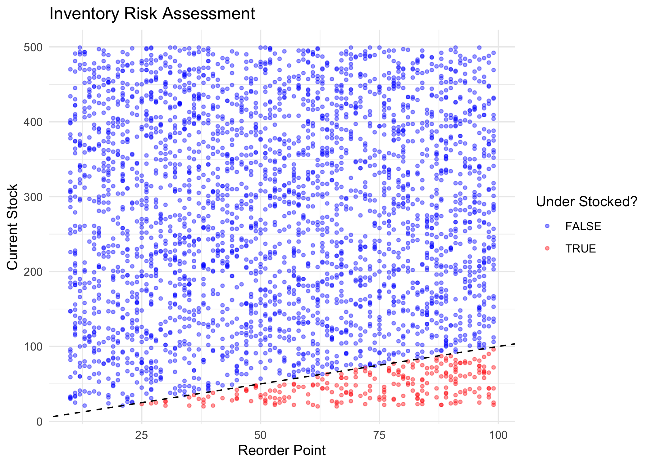
Visualizations

Slide 9

Correlation Analysis
Correlation (r): approximately -0.0139
p-value: 0.4321
A Pearson correlation test was run to evaluate whether daily_demand is linearly associated with reorder_point.

Slide 10
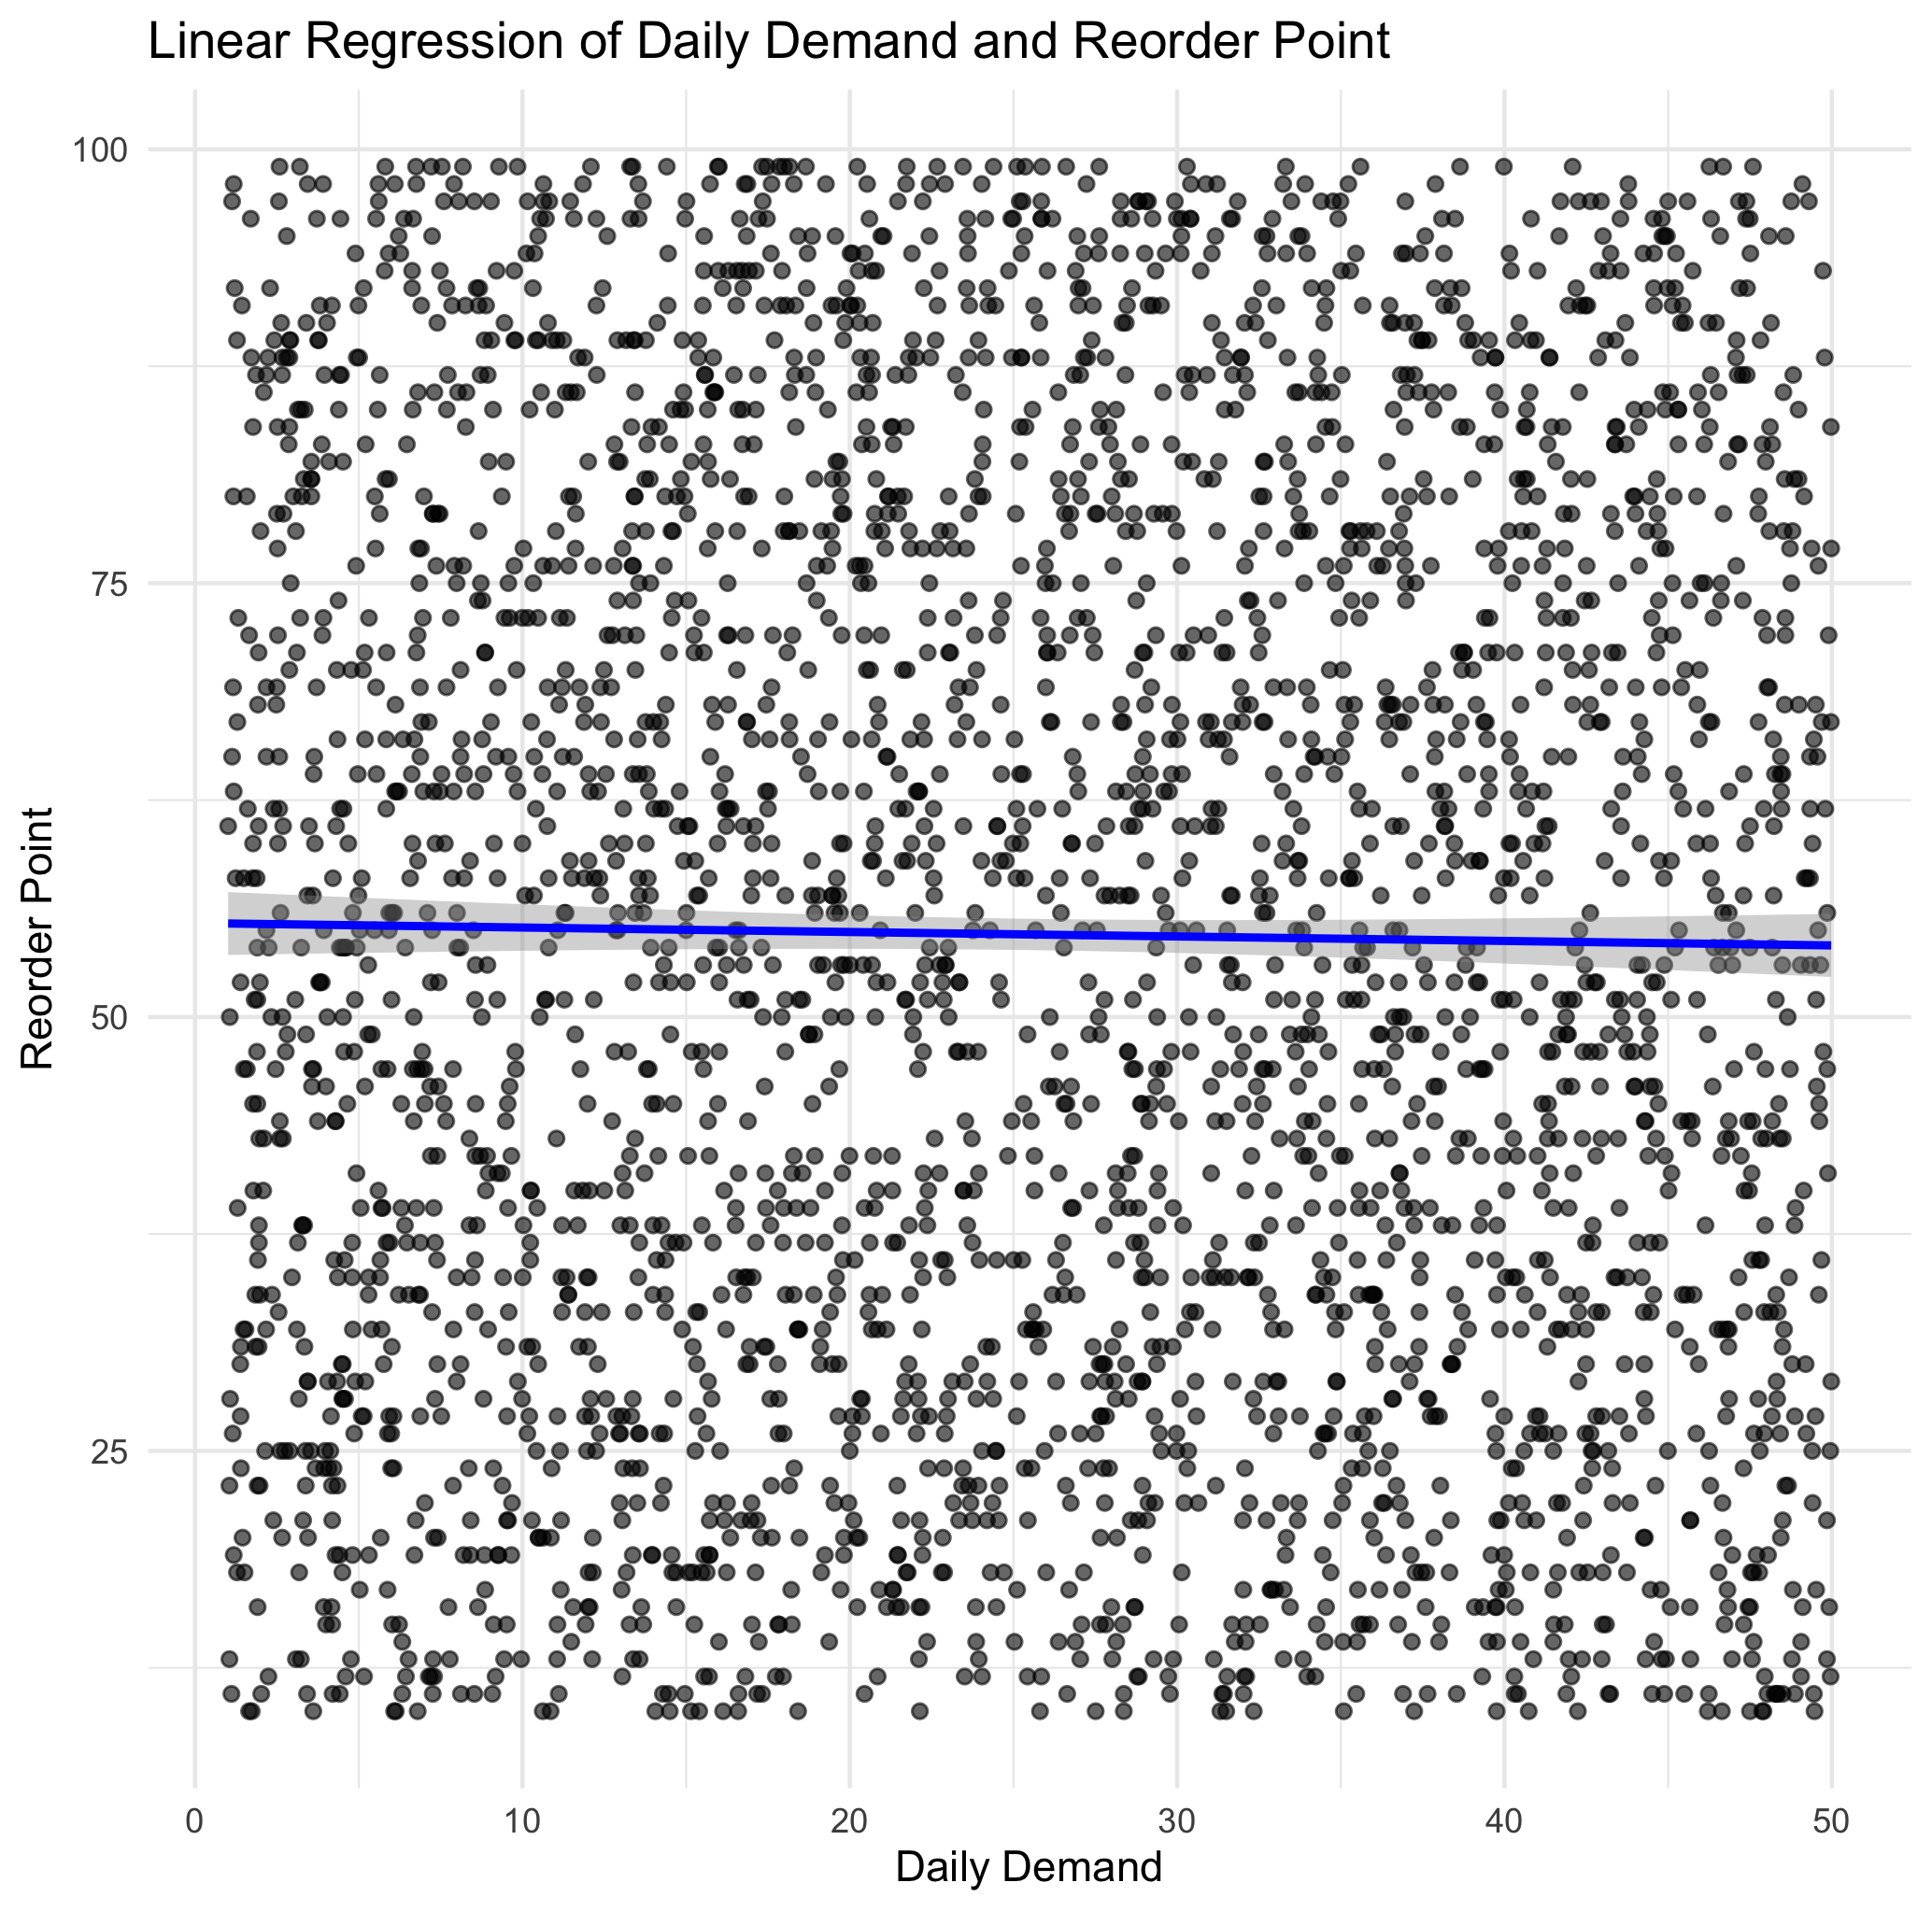
Regression Analysis
Interpretation: changes in daily demand do not meaningfully predict changes in reorder points.

Slide 11
Key Takeaways
reorder point settings do not reflect observed daily demand patterns in the dataset
Prioritize high-risk ones (Zones B and C) for replenishment policy checks and corrective action.
Implement regular inventory dashboards that track under-stocked items by zone and monitor alignment between stock levels and reorder thresholds.

Slide 12
References
Data Science Process Alliance. (2024, December 9). What is CRISP-DM? https://www.datascience-pm.com/crisp-dm-2/
Ziya07. (2025, July 29). Logistics warehouse dataset [Data set]. Kaggle. https://www.kaggle.com/datasets/ziya07/logistics-warehouse-dataset
Wickham, H. (2016). ggplot2: Elegant graphics for data analysis. Springer-Verlag New York. https://ggplot2.tidyverse.org
Wickham, H., François, R., Henry, L., Müller, K., & Vaughan, D. (2026). dplyr: A grammar of data manipulation (R package version 1.2.1) [Computer software]. https://dplyr.tidyverse.org

